Slide 1
Project Employ Management System Teacher : Sir Khawar Iqbal
Group Members Name :
Muhammad Abubakar Khan (48678 BSSE-1C)
Uzair Hassan (48525 BSSE-1C)
Daniyal Wajid (48528 BSSE-1C)

Slide 2
Introduction
The Employee Management System project is to develop a system that enhances a company's operations and improves performance and productivity.
The objective of this project is to create a system that controls and manages the information at all levels.
It can perform the following tasks.
Add new employee
View single employee details
List of Employees
Update an employee’s id
Delete an employee

Slide 3
Methodology
STRUCTURE ( Made for Employee to enhance system )
FUNCTIONS ( To manage data easily in program )
SWITCHES ( To choose any one case )
FILE HANDLING ( To manage data for reuse )
LOOPS ( To get and check Data )
TOOL ( Dev C++ )

Slide 4
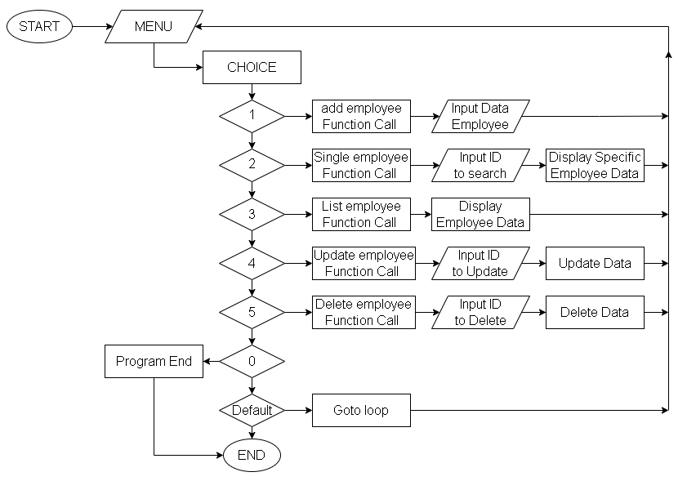
Flow Chart

Slide 5
Conclusion
With this program we can easily manage record of employee’s.
Less time consuming
Increased Productivity
Securing Employee Data
Create a smooth onboarding process

